Slide 1

Capstone Final Project
Adrian Winkler

Slide 2
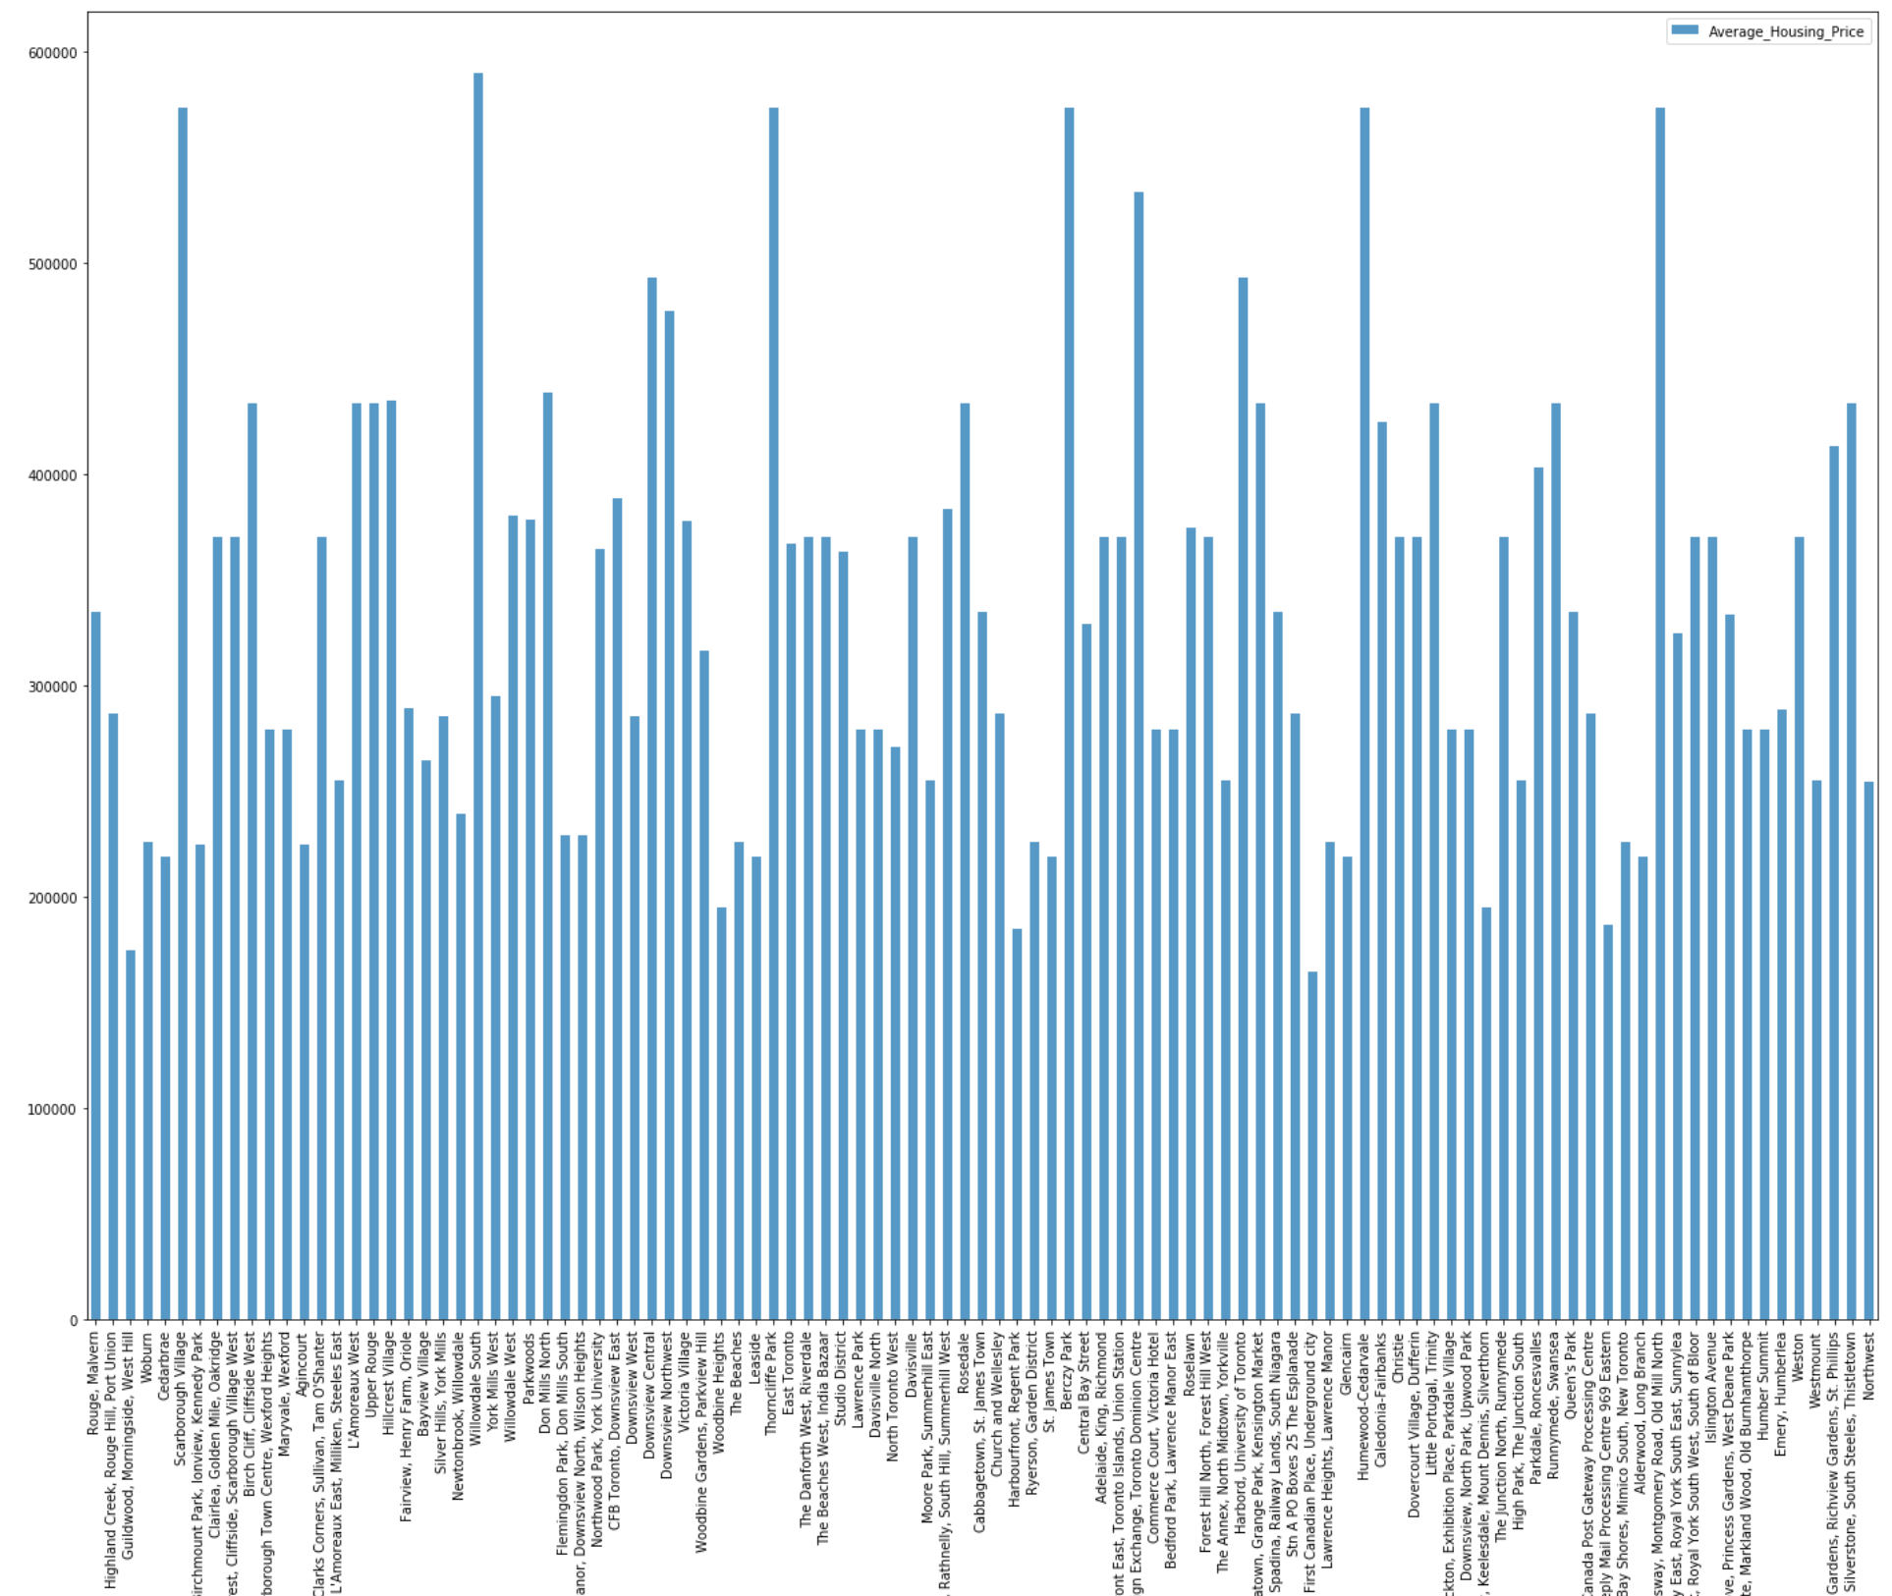
Average Housing Price by Clusters in Scarborough

Slide 3
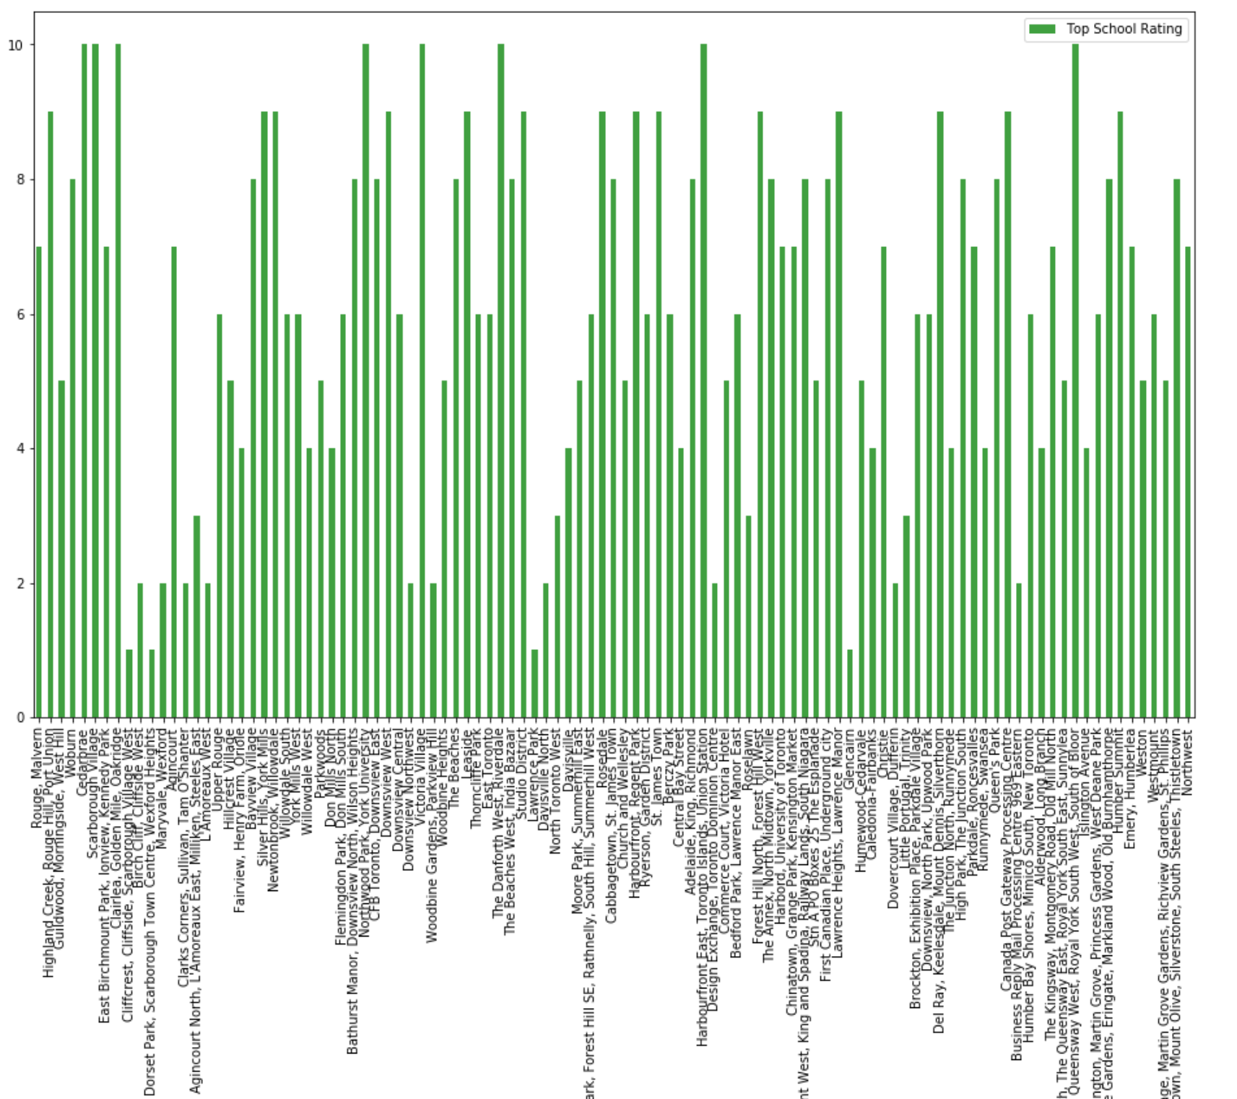
School Ratings by Clusters in Scarborough

Slide 4
Conclusion
Problem Which Tried to Solve: The major purpose of this project, is to suggest a better neighborhood in a new city for the person who are shiffting there. Social presence in society in terms of like minded people. Connectivity to the airport, bus stand, city center, markets and other daily needs things nearby.
Sorted list of house in terms of housing prices in a ascending or descending order Sorted list of schools in terms of location, fees, rating and reviews

